Slide 1
DATA ANALYTICS|SCIENCE
WHY|HOW TO BREAK INTO DATA SCIENCE?
SMR 3268
franckalbinet@gmail.com

Slide 2
1. DATA SCIENCE INTRODUCTION |AN OVERVIEW
2. PREDICTION MACHINES | THE ENGINE
3. DEPLOYMENT MOMENTUM
4. [POTENTIAL] TRACKS TO DEVELOP CAPACITIES

Slide 3
1. DATA SCIENCE INTRODUCTION |AN OVERVIEW
2. PREDICTION MACHINES | THE ENGINE
3. DEPLOYMENT MOMENTUM
4. [POTENTIAL] TRACKS TO DEVELOP CAPACITIES

Slide 4
IoT PROVIDES
[PARTIAL] OBSERVATION OF THE WORLD
DATA SCIENCE HARNESS IT
TO INFORM DECISION
Notes:
- Collecting data is not an end in itself
Data is data, meaning should be given, contextualized
Data collection is justified by a pre-defined goal, a decision to make
Domain knowledge plays a key role
Decision is the objective, data is the mean to reach it
Data Science might loop back to IoT through actuators

Slide 5
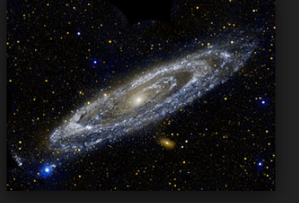
DATA SCIENCE PIPELINE
RAW DATA
COLLECTED
DATA IS
PROCESSED
EXPLORATORY
DATA ANALYSIS
MAKE
DECISIONS
MODEL &
ALGORITHMS
« REALITY »
Notes:
Communicate
Inject domain knowledge when/if required
Provide data product
Highly iterative

Slide 6
EXAMPLE OF AIR QUALITY MONITORING SYSTEM
Notes:
Data Science without data is an empty shell
We should know why and what for we collect data and how
Data Science

Slide 7
I. PRIMARY DATA
IoT NETWORK SENSES PARTICULATE MATTERS (PM), CO2, …
Notes:
Data Science without data is an empty shell
We should know why and what for we collect data and how

Slide 8
II. SECONDARY DATA
THE DATA ANALYSIS PIPELINE TAPS INTO SOCIAL NETWORKS, METEOROLOGICAL FORECASTS, CROWD-SOURCED, …

Slide 9
III. DATA SCIENCE PIPELINE « STIRS » DATA
PERFORMS SPATIAL INTERPOLATION, SENTIMENT ANALYSIS, HARNESSES METEOROLOGICAL DATA, OUTPUTS DIAGNOSIS, PROGNOSIS

Slide 10
IV. DECISION MAKERS …
INTERPRET OUTPUTS IN A WIDER CONTEXT, CONTROL ROAD TRAFFIC, ENFORCE RESTRICTION USE, PROVIDE FEEDBACK TO IMPROVE THE WHOLE VALUE CHAIN

Slide 11
QUIZ
COLLECT AS MUCH DATA AS YOU CAN!
DATA SCIENCE = [ADVANCED] STATISTICS
NEITHER IOT NOR DATA SCIENCE IS REALLY NEW
DOMAIN KNOWLEDGE DOES NOT MATTER NOWADAYS
Notes:
Data Science without data is an empty shell
We should know why and what for we collect data and how
Data Science

Slide 12
WHAT MAKES DATA SCIENCE « UNIQUE »
DATA
ENGINEERING
SCIENTIFIC
METHOD
DOMAIN
EXPERTISE
MATHEMATICS
DATA SCIENCE
HACKER
MINDSET
STATISTICS
« ADVANCED »
COMPUTING
VISUALIZATION

Slide 13
A HIERARCHY OF BUZZ WORDS
DATA SCIENCE
ARTIFICIAL INTELLIGENCE (AI)
MACHINE LEARNING (ML)
DEEP LEARNING (DL)
Notes:
Let’s try to define the top of the hierarchy by examples

Slide 14
AN AUTHORITATIVE DEF. OF ML BUT …
« A COMPUTER PROGRAM IS SAID TO LEARN FROM EXPERIENCE E WITH RESPECT TO SOME CLASS OF TASKS T AND PERFORMANCE MEASURE P, IF ITS PERFORMANCE AT TASKS IN T, AS MEASURED BY P, IMPROVES WITH EXPERIENCE E »
---- TOM MITCHELL, MACHINE LEARNING

Slide 15
ANOTHER ONE
« MACHINE LEARNING IS THE FIELD OF STUDY THAT GIVES COMPUTER THE ABILITY TO LEARN WITHOUT BEING EXPLICITLY PROGRAMMED »
---- ARTHUR SAMUEL, 1959

Slide 16
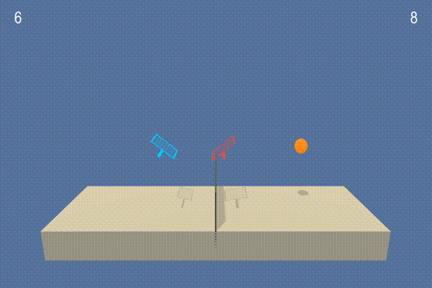
A COMPELLING EXAMPLE: TENNIS [UNSOLVED]
* Play the powerpoint version to see the animation

Slide 17
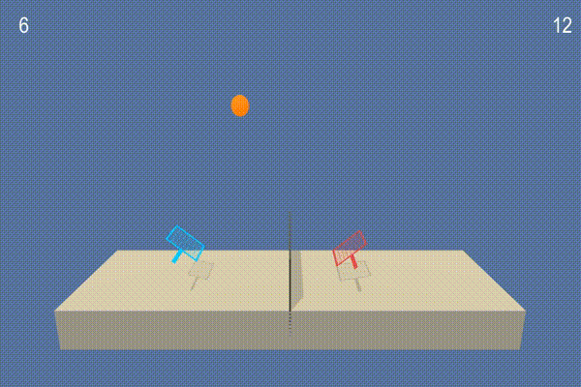
TENNIS [SOLVED AFTER 5 MIN TRAINING ON STANDARD LAPTOP]
* Play the powerpoint version to see the animation

Slide 18
QUICK NOMENCLATURE OF ML « PARADIGMS »

Slide 19





SUPERVISED LEARNING
MODEL
NEW RESPONSE
KNOWN DATA
?
THESE ARE CATS
NEW DATA
KNOWN RESPONSE

Slide 20


UNSUPERVISED LEARNING
I CAN SEE A PATTERN
MODEL
INPUT DATA

Slide 21


REINFORCEMENT LEARNING
ENVIRONMENT
OBSERVE ITS STATE
GET REWARD
ACT
AGENT

Slide 22
NAVIGATE DATA SCIENCE | ML | DL | AI APPLICATIONS
LIST APPLICATIONS YOU CAN THINK OF.
HOW COULD YOU GROUP THEM?

Slide 23
BY TECHNOLOGY TYPE
IMAGE RECOGNITION
OBJECT DETECTION
NATURAL LANGUAGE PROCESSING, SPEECH RECOGNITION
TIME SERIES PREDICTION
ROBOTIC
GAMES & SIMULATION, …

Slide 24
BY ACTIVITY SECTORS
HEALTH
AGRICULTURE, ENVIRONMENT
EDUCATION & SCIENCE
INDUSTRY
DEFENCE, ...
Notes:
But many are tansectoral:
Transportation
Logistics
Energy
Virtual assistant

Slide 25
QUICK TOUR OF EXAMPLE APPLICATIONS
FROM OBJECT DETECTION TO MUSIC

Slide 26
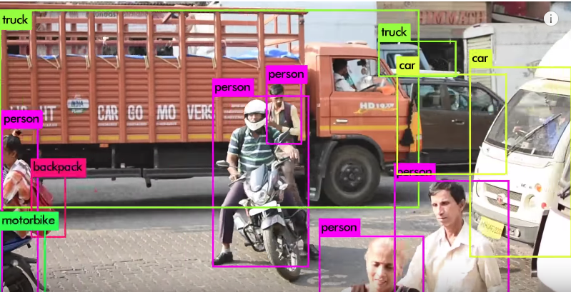
REAL TIME OBJECT DETECTION
https://pjreddie.com/darknet/yolo

Slide 27
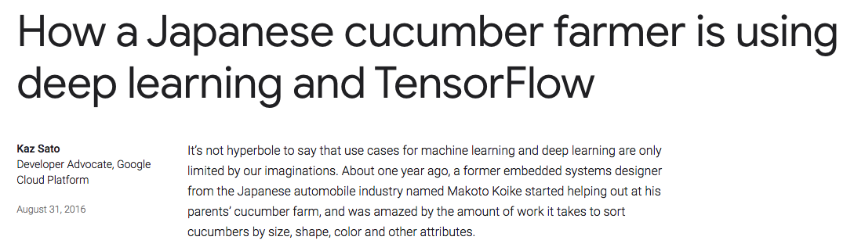
SMART FARMING
https://tinyurl.com/y7js7scm

Slide 28
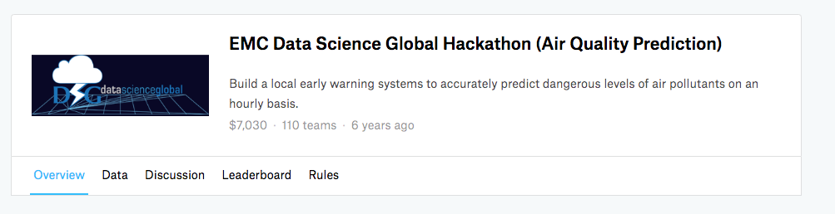
AIR QUALITY PREDICTION
https://www.kaggle.com/c/dsg-hackathon

Slide 29

ENERGY CONSUMPTION
https://deepmind.com/blog/deepmind-ai-reduces-google-data-centre-cooling-bill-40/

Slide 30
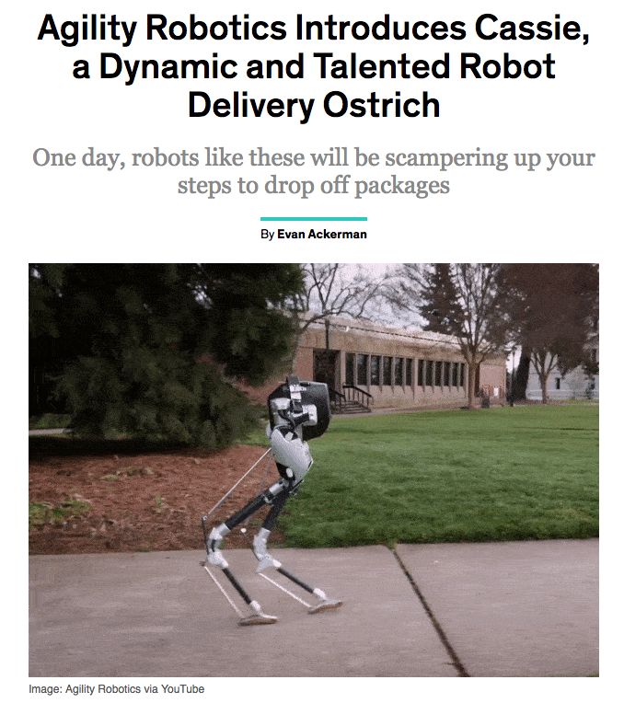
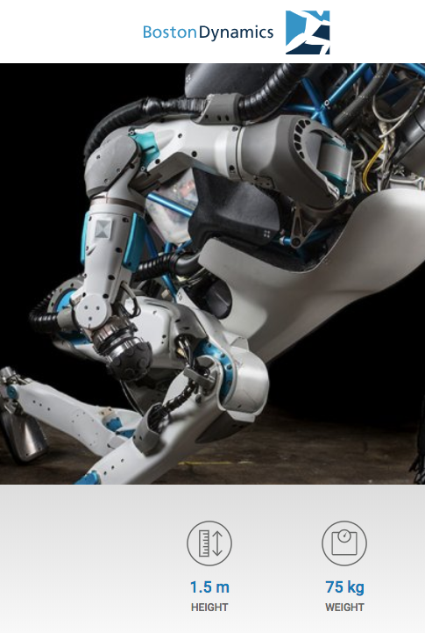
ROBOTICS
https://tinyurl.com/y7v433fs
https://www.bostondynamics.com/atlas

Slide 31
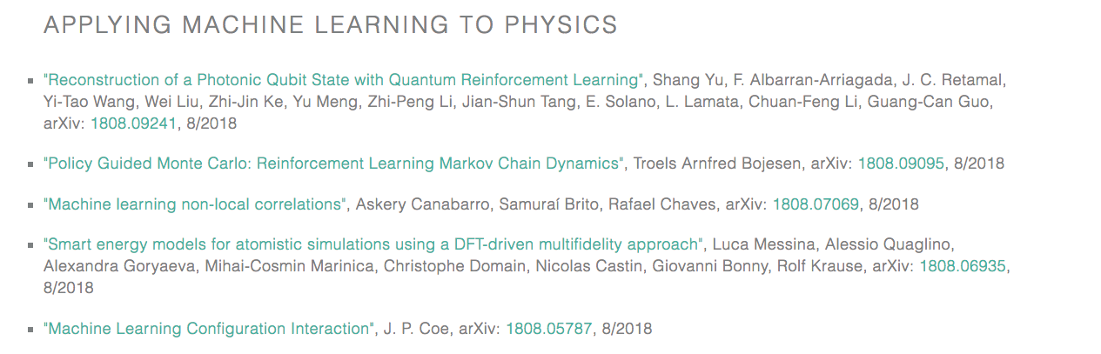
PHYSICS
https://physicsml.github.io/pages/papers.html

Slide 32


MEDICINE
https://deepmind.com/blog/alphafold/
https://www.sophiagenetics.com

Slide 33

MUSIC
https://magenta.tensorflow.org/

Slide 34
AN ENDLESS LIST …

Slide 35
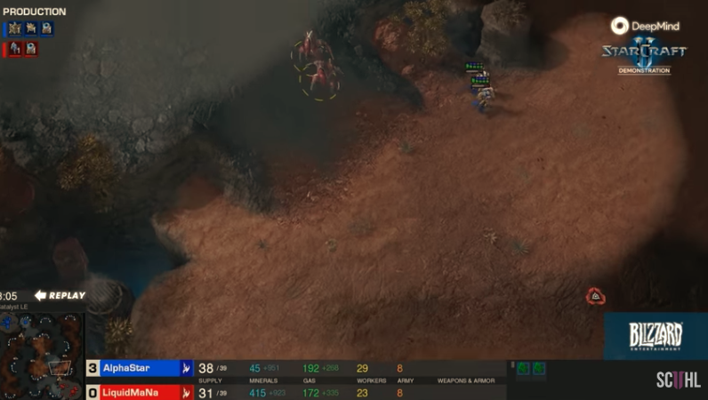
BREAKING NEWS: DEEPMIND « STARCRAFT » LAST WEEK BREAKTHROUGH
https://www.youtube.com/watch?v=cUTMhmVh1qs

Slide 36
WHAT IS AT THE CORE OF ALL THESE APPLICATIONS?

Slide 37
1. DATA SCIENCE INTRODUCTION |OVERVIEW
2. PREDICTION MACHINES | THE ENGINE
3. DEPLOYMENT MOMENTUM
4. [POTENTIAL] TRACKS TO DEVELOP CAPACITIES

Slide 38
PREDICTION AS A CORE COMPONENT OF DATA SCIENCE | ML | DL | AI
PREDICTING STOCK MARKET
PREDICTING WHO IS IN THE VIDEO
PREDICTING A SERIOUS DISEASE
PREDICTING POLLUTION PEACK
…

Slide 39
WHAT IS A PREDICTION?

Slide 40
PREDICTION AS A PROCESS TO FILL MISSING INFORMATION
INFORMATION
YOU HAVE
INFORMATION
YOU DON’T HAVE
Notes:
Use information you have to generate information you don’t have

Slide 41
PREDICTION VS. DECISION MAKING ?

Slide 42
UNPACKING DECISION MAKING
PREDICTION IS ONLY ONE KEY ELEMENT WITH
JUDGMENT
ACTIONS
OUTCOME & FEEDBACK

Slide 43
HUMAN VS. MACHINE
MACHINE| AI BEAT HUMAN IN MANY NARROW TASKS
HUMAN ARE BETTER WITH FEW DATA [MODEL OF THE WORLD]
HUMAN PUT PREDICTIONS INTO CONTEXT AND ASSESS TRADEOFFS
REQUIRE RETHINKING MANY JOBS
SOCIALIZE TO KEEP YOUR JOB ?

Slide 44
COGNITIVE LABOUR RISKF OF REPLACEMENT
SOCIAL
TEACHER
CEO
OPTIMIZATION-BASED
CREATIVITY- OR STRATEGY-BASED
SCIENTIST
ASOCIAL

Slide 45
SOCIAL
TEACHER
CEO
OPTIMIZATION-BASED
CREATIVITY- OR STRATEGY-BASED
SCIENTIST
ASOCIAL

Slide 46
PHYSICAL
LABOR
SOCIAL
LOW DEXTERITY AND
STRUCTURED ENVIRONMENT
HIGH DEXTIRITY AND UNSTRUCTURED ENVIRONMENT
ASOCIAL

Slide 47
PREDICTIONS MACHINE | OPENING THE ENGINE
AN ATTEMPT TO DEMISTIFY ML|DL

Slide 48
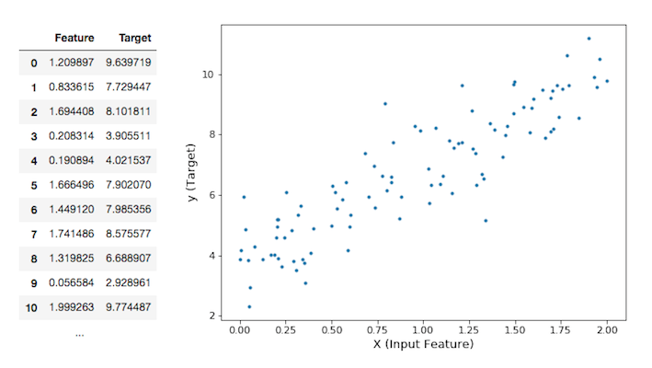
IS THERE ANY PATTERN IN YOUR DATA?

Slide 49
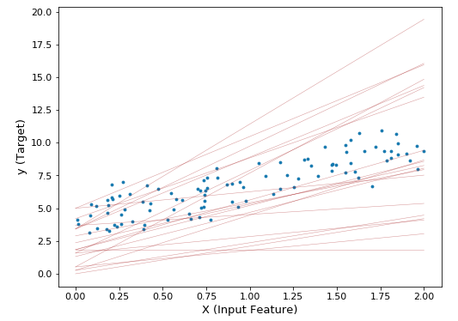
BUT WHICH LINE?

Slide 50
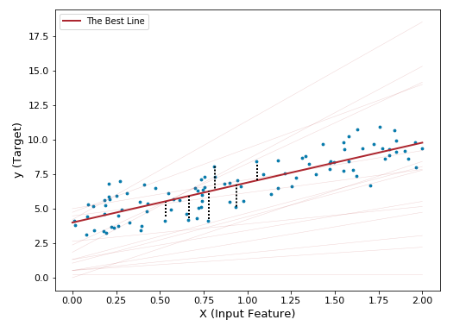
DEFINE AN EVALUATION METRIC?

Slide 51
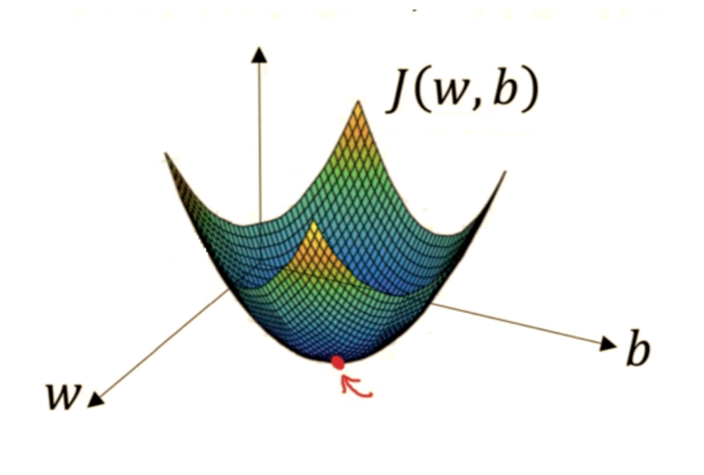
MINIMIZE ERROR

Slide 52
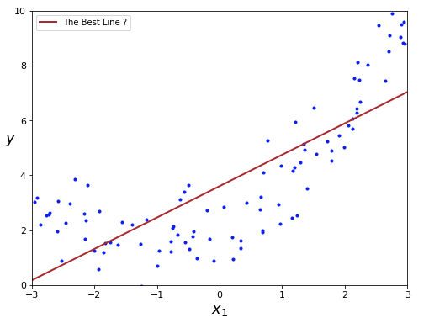
BUT WAIT, WHICH BEST LINE?
https://github.com/ageron/handson-ml2

Slide 53
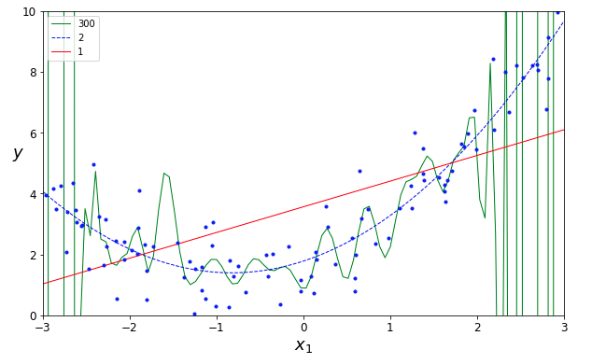
WHICH CURVE IS BEST? A QUESTION OF CAPACITY
https://github.com/ageron/handson-ml2

Slide 54
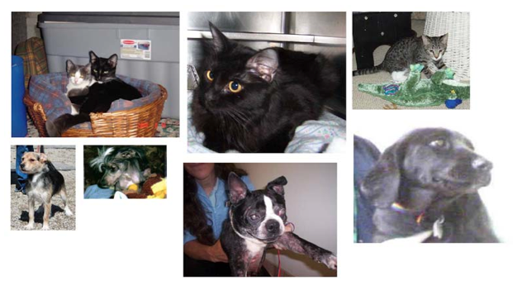
WHAT ABOUT CLASSIFICATION PROBLEM?

Slide 55
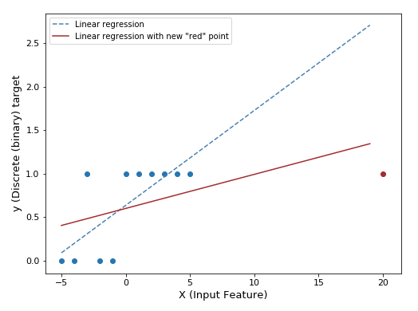
LOGISTIC REGRESSION RATIONALE

Slide 56
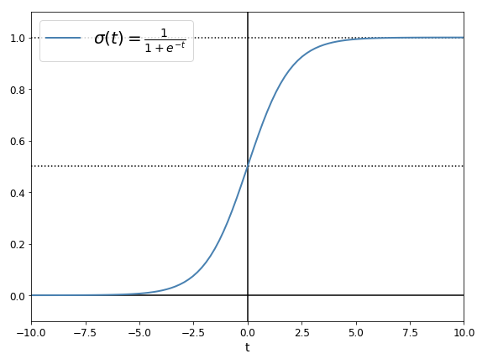
LOGISTIC REGRESSION | SIGMOID FUNCTION

Slide 57
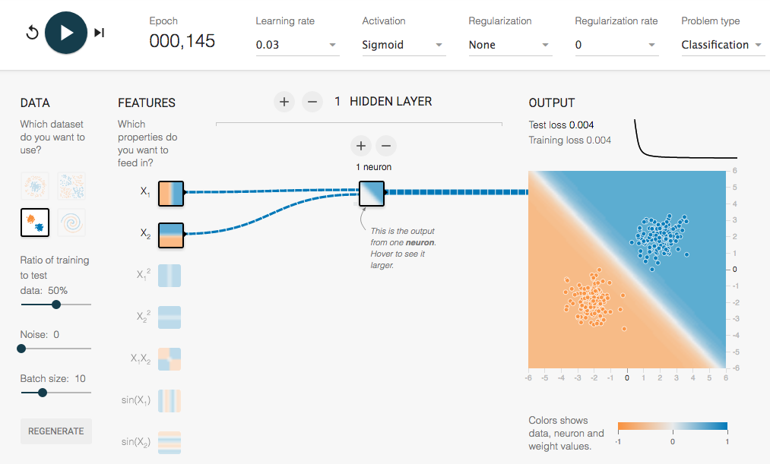
LOGISTIC REGRESSION | AT CRUISING SPEED
http://playground.tensorflow.org/
https://goo.gl/d5wwH3

Slide 58
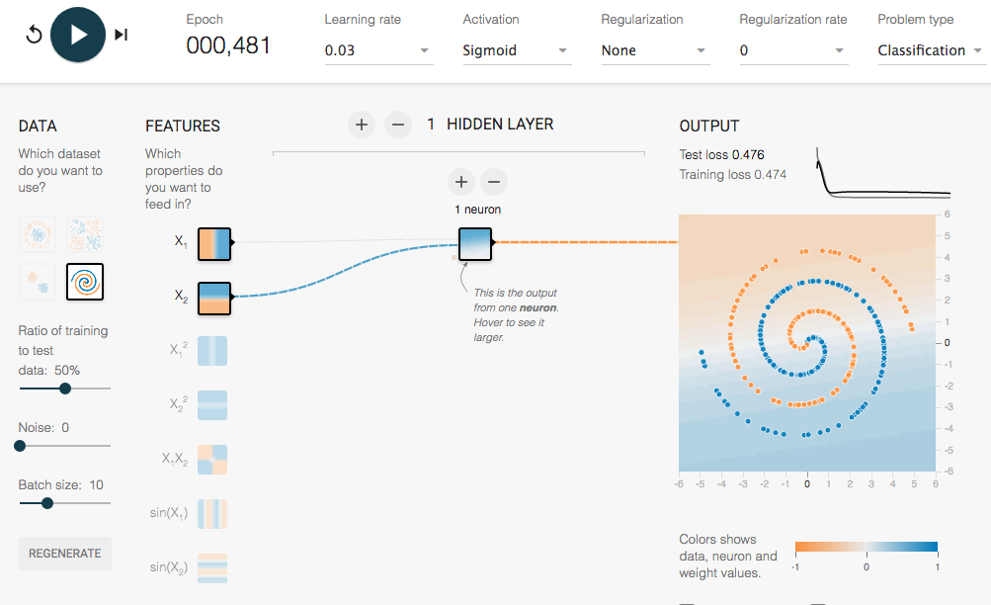
LOGISTIC REGRESSION | IN TROUBLE

Slide 59
LOGISTIC REGRESSION | IN TROUBLE

Slide 60
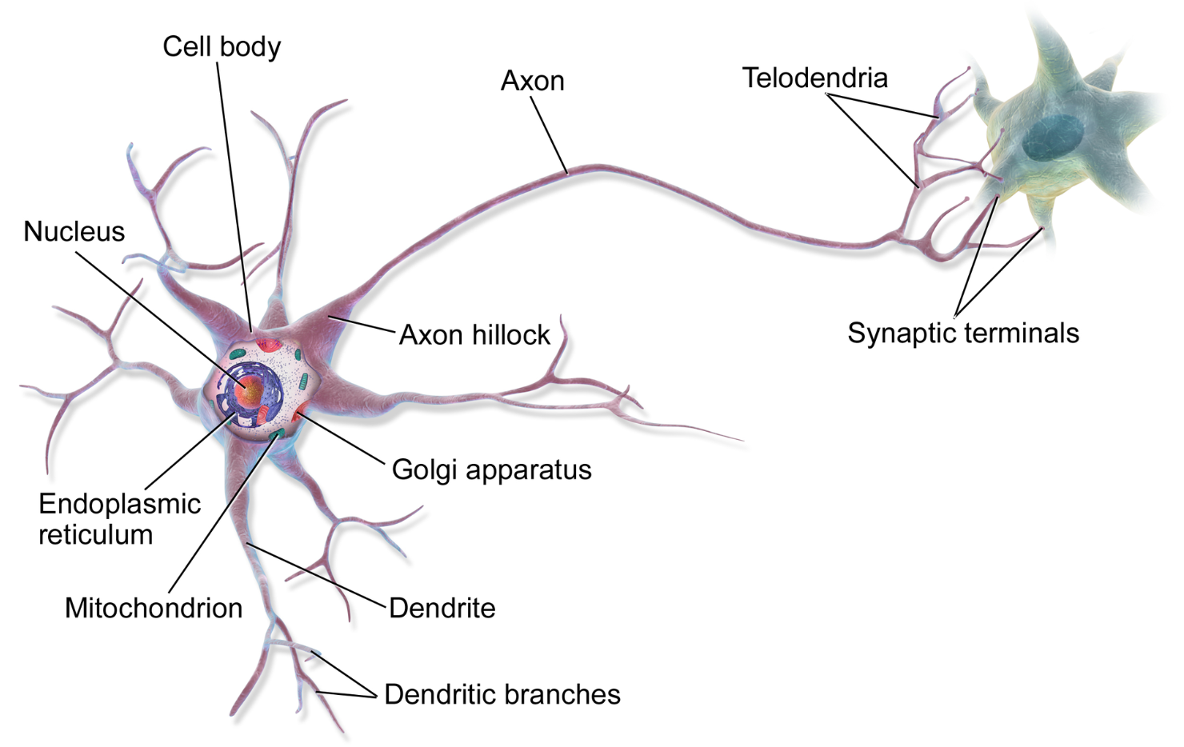
BIOLOGICAL NEURON
https://en.wikipedia.org/wiki/Neuron#/media/File:Blausen_0657_MultipolarNeuron.png

Slide 61
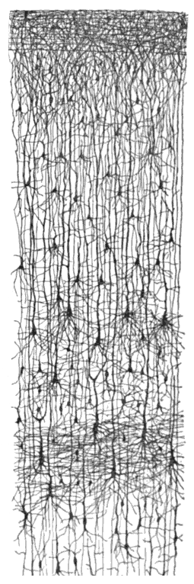
MULTIPLE LAYERS IN BIOLOGICAL NEURAL NETWORK
https://en.wikipedia.org/wiki/Cerebral_cortex

Slide 62
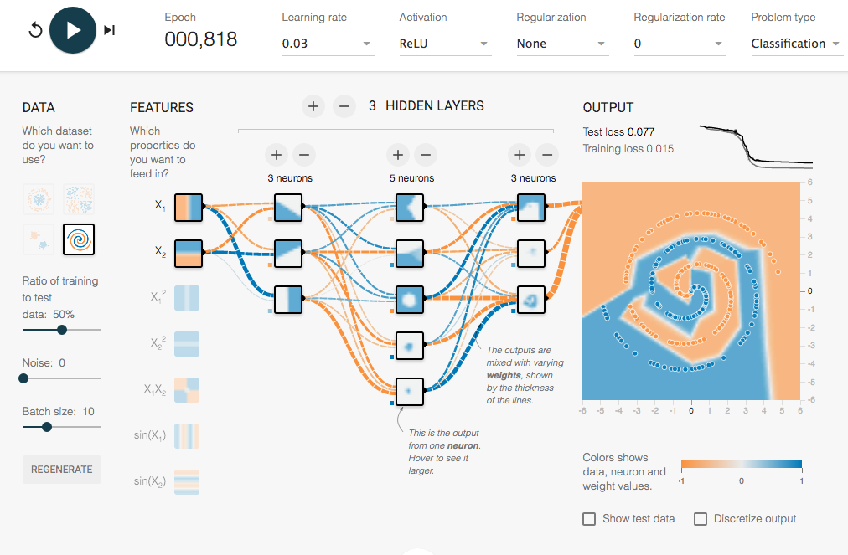
ARTIFICIAL NEURAL NETWORKS COMES ON STAGE
https://goo.gl/ngcvpV

Slide 63
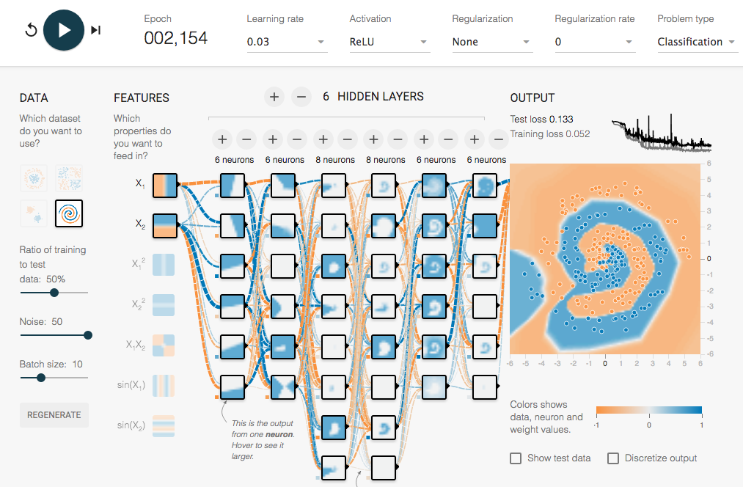
ARTIFICIAL DEEP NEURAL NETWORKS COMES ON STAGE
https://goo.gl/6BJ83E

Slide 64
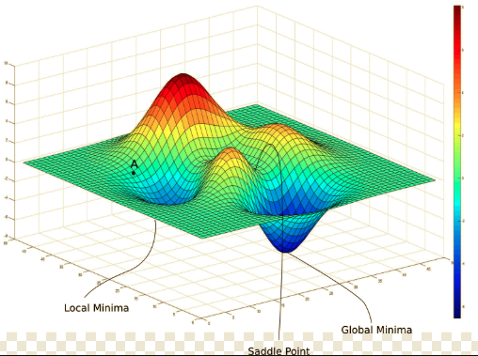
NOT A BOIL ANYMORE | OPTIMIZATION TRICKS

Slide 65
FROM TWO PARAMETERS TO MILLIONS OF THEM
« WITH FOUR PARAMETERS I CAN FIT AN ELEPHANT, AND WITH FIVE I CAN MAKE HIM WIGLLE HIS TRUNK»
---- JOHN VON NEUMANN

Slide 66
FINETUNING YOUR « MOULD » | CAPACITY
OVERFITTING AND UNDERFITTING

Slide 67

ML PRACTITIONER MINDSET | PREDICTIVE POWER FIRST

Slide 68
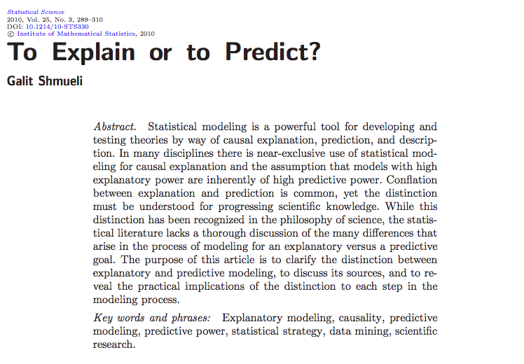
AS OPPOSED TO CLASSICAL STATISTICS MINDSET
HIGH EXPLANATORY POWER = HIGH PREDICTIVE POWER
https://arxiv.org/pdf/1101.0891.pdf

Slide 69
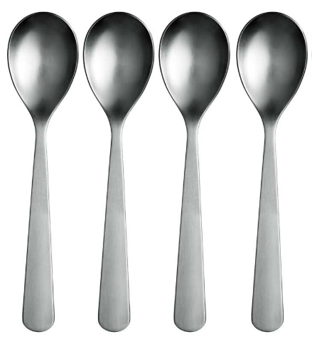
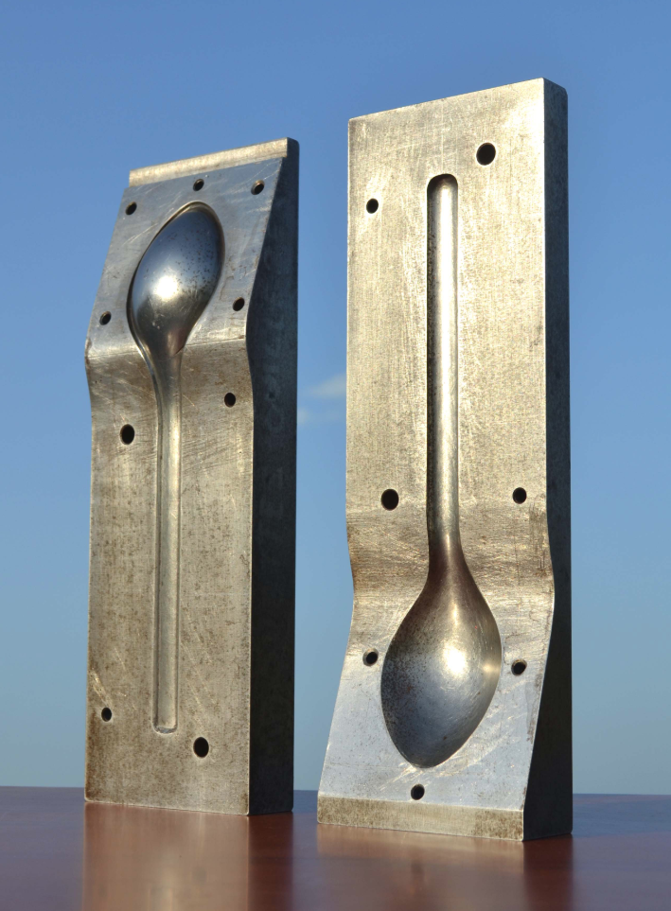
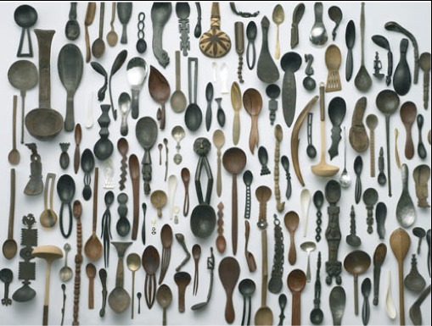
RIGHT DATA & RIGHT MODEL CAPACITY
TRAINING DATASET
MODEL “MOULD”
TEST DATASET
https://goo.gl/i2RCXF
http://www.20th.ch/antiquites_industrielles_objets.htm
PHOTO BY KENICHI HIGASHI

Slide 70
« UNIVERSAL » WORKFLOW OF DEEP LEARNING
DEFINE THE PROBLEM AND ASSEMBLE A DATASET
CHOOSE A MEASURE OF SUCCESS & DECIDE ON AN EVALUATION PROTOCOL
PREPARE DATA
DEVELOP A MODEL THAT DOES BETTER THAN A BASELINE
TWEAK CAPACITY BY TUNING YOUR HYPERPARAMETERS

Slide 71
« UNIVERSAL » WORKFLOW OF DEEP LEARNING
DEFINE THE PROBLEM AND ASSEMBLE A DATASET
CHOOSE A MEASURE OF SUCCESS & DECIDE ON AN EVALUATION PROTOCOL
PREPARE DATA
DEVELOP A MODEL THAT DOES BETTER THAN A BASELINE
TWEAK CAPACITY BY TUNING YOUR HYPERPARAMETERS

Slide 72
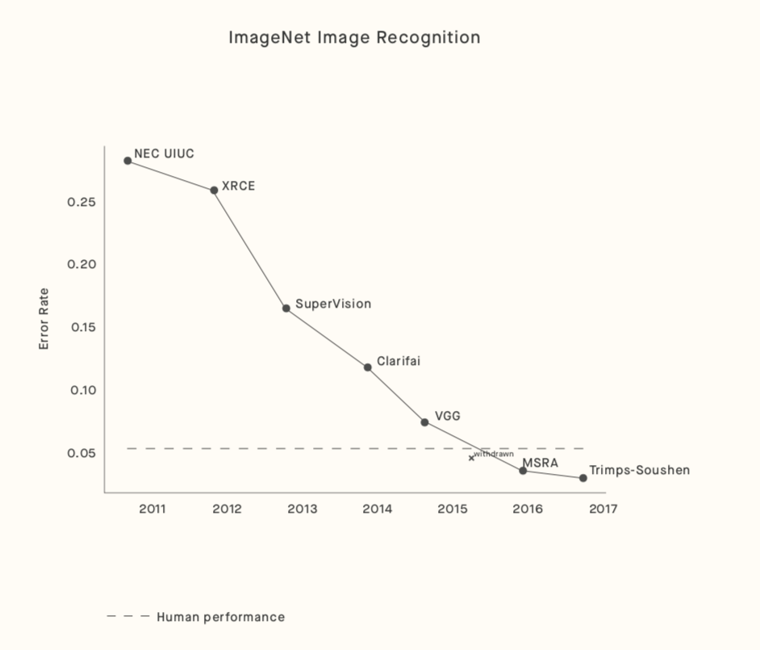
ML|DL|AI VS. HUMAN
DEEP LEARNING > HUMAN-LEVEL PERFORMANCE
BUT IN PARTICULAR DOMAINS (IMAGE RECOGNITION, …)
BUT ON VERY SPECIFIC/NARROW TASKS [FOR NOW]
https://arxiv.org/pdf/1802.07228.pdf
http://www.image-net.org/

Slide 73
1. DATA SCIENCE INTRODUCTION |OVERVIEW
2. PREDICTION MACHINES | THE ENGINE
3. DEPLOYMENT MOMENTUM
4. [POTENTIAL] TRACKS TO DEVELOP CAPACITIES

Slide 74
LURING WITH SIREN SONGS
« DATA IS THE NEW OIL »
« AI IS THE NEW ELECTRICITY »
« THE FOURTH INDUSTRIAL REVOLUTION »
…
Notes:
Might be valid statement but what is marketing, what is branding, what is real ?
The risk of many expectations that could be disappointed …
- First IR: iron, textile industry with steam machine 18th-19th
- Second IR: oil and electricity – before first world war
- Third IR: Digital revolution – after 80’s
- Fourth: now ??

Slide 75
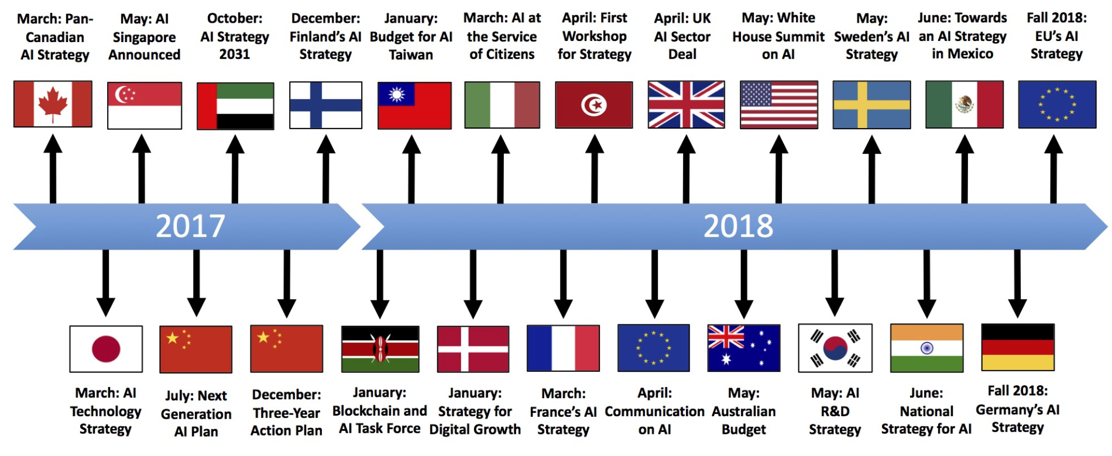
AN IDEA OF THE RUSH
Source: https://medium.com/politics-ai/an-overview-of-national-ai-strategies-2a70ec6edfd

Slide 76
THE STUFF OF AN AI SUPERPOWER
ABUNDANT DATA
TENACIOUS ENTREPRENEURS*
WELL TRAINED AI PRACTITIONERS
SUPPORTIVE POLICY ENVIRONMENTS*
https://aisuperpowers.com/
* ON STRATEGIC SECTOS

Slide 77

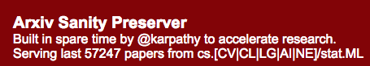
FAST-PACED RESEARCH VS. NARROW AI
https://arxiv.org/
http://www.arxiv-sanity.com/
Notes:
Flood of media attention might distort a bit the reality and what’s “mature“

Slide 78
1. DATA SCIENCE INTRODUCTION |OVERVIEW
2. PREDICTION MACHINES | THE ENGINE
3. DEPLOYMENT MOMENTUM
4. [POTENTIAL] TRACKS TO DEVELOP CAPACITIES

Slide 79
ML/DL/AI DEMOCRATIZATION
OUTSTANDING ONLINE COURSES
BEST PRATICES DISSEMINATION
COMPETITIONS

Slide 80
SOME OUTSTANDING RESOURCES ONLINE
https://www.datacamp.com
https://www.deeplearning.ai/
https://www.fast.ai/
https://eu.udacity.com/
https://spinningup.openai.com

Slide 81
ML COMPETITIONS
https://www.kaggle.com/competitions
https://zindi.africa/
https://challenger.ai/

Slide 82
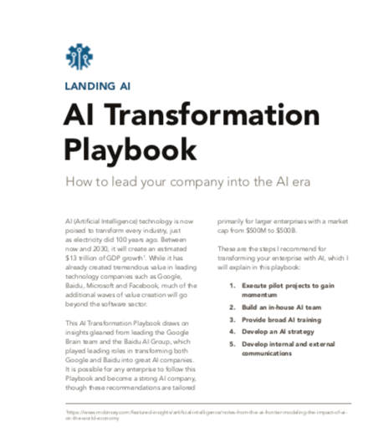
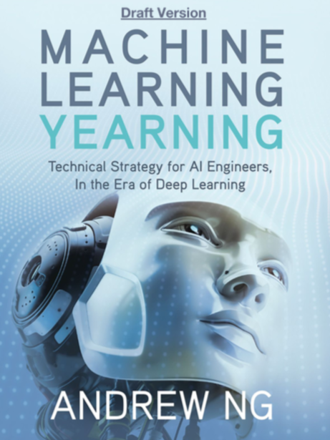
BEST PRACTICES
http://www.mlyearning.org/

Slide 83

OUTSTANDING PYTHON REFERENCE BOOKS
https://github.com/wesm/pydata-book
https://github.com/ageron/handson-ml
https://github.com/fchollet/deep-learning-with-python-notebooks

Slide 84
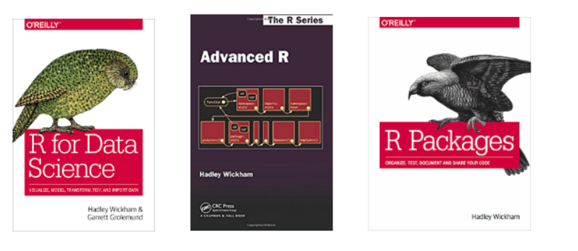
OUTSTANDING R REFERENCE BOOKS [FREE]
http://r4ds.had.co.nz/
http://adv-r.had.co.nz/
http://r-pkgs.had.co.nz/

Slide 85
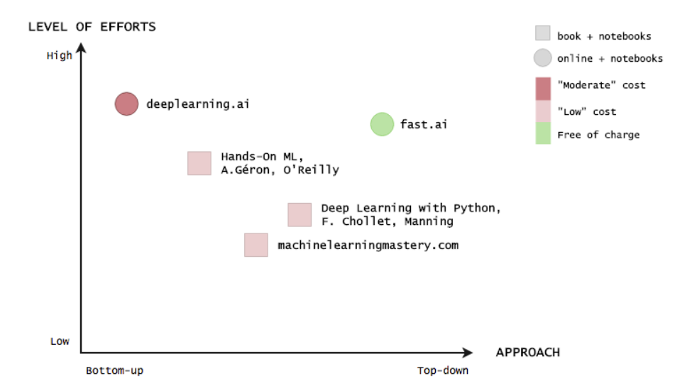
A DIVERSITY OF APPROACHES BUT ALL GOOD!

Slide 86
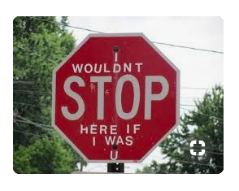
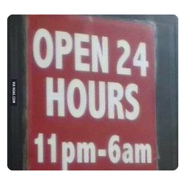
AT ADRIATICO GUEST HOUSE
TILL THURSDAY EVENING

